Slide 1

Customer Shopping Behavior Analysis

Slide 2

Project Overview
1
2
Goal
Purpose
Uncover insights from 3900 purchases.
Guide strategic business decisions.
3
Focus
Spending, segments, preferences, subscriptions.

Slide 3

Dataset Summary
Rows: 3,900Columns: 18
Customer demographics
Purchase details
Shopping behavior
Missing Data: 37 values in Review Rating

Slide 4

Exploratory Data Analysis (Python)
01
Data Preparation
Loading, initial exploration, missing data handling.
02
Standardization
Renamed columns to snake case.
03
Feature Engineering
Age groups, purchase frequency.
04
Integration
Loaded into PostgreSQL for SQL analysis.

Slide 5
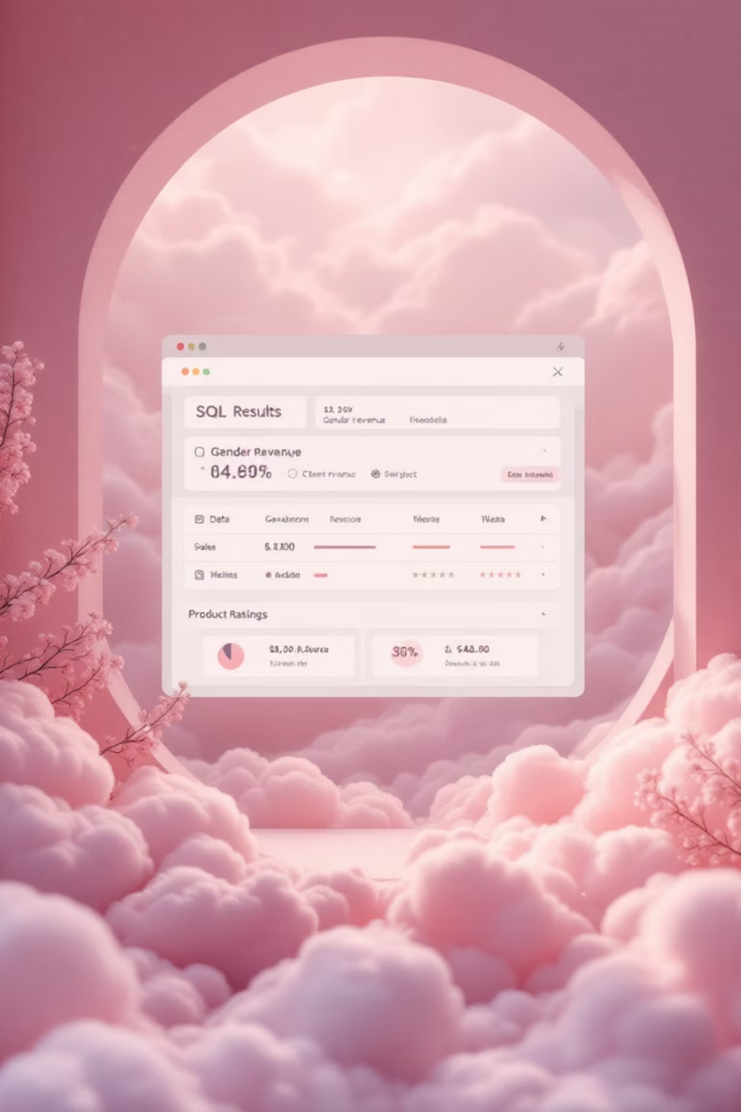
SQL Analysis: Key Business Questions
1
Revenue by Gender
Comparing male vs. female customer revenue.
2
High-Spending Discount Users
Customers with above-average spend despite discounts.
3
Top 5 Products by Rating
Products with highest average review ratings.
4
Shipping Type Comparison
Average purchase amounts for Standard vs. Express.

Slide 6

SQL Analysis: Deeper Insights
Subscribers vs. Non-Subscribers
Discount-Dependent Products
Average spend and total revenue comparison.
Top 5 products with highest discounted purchases.
Customer Segmentation
New, Returning, Loyal based on purchase history.

Slide 7




SQL Analysis: Product & Age Focus
Top 3 Products per Category
Repeat Buyers & Subscriptions
Revenue by Age Group
Most purchased items within each category.
Total revenue contribution from each age group.
Likelihood of subscription for frequent purchasers.

Slide 8

Interactive Dashboard in Power BI
Visualizing insights for easy understanding.

Slide 9
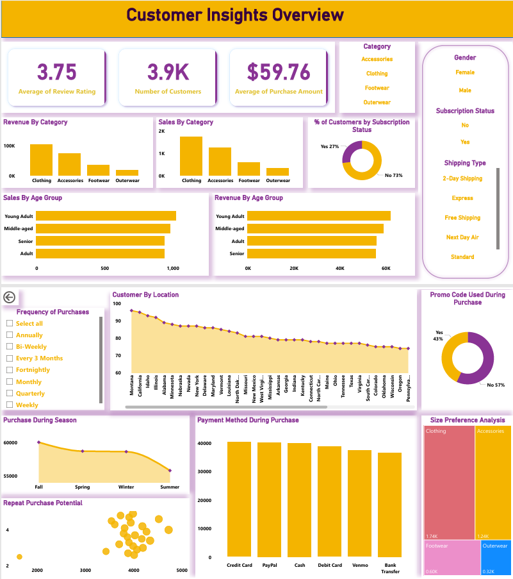
Dashboard Deep Dive
A closer look at the interactive data presentation.

Slide 10





Business Recommendations
Boost Subscriptions
Promote exclusive benefits.
Customer Loyalty
Reward repeat buyers.
Review Discount Policy
Balance sales with margins.
Targeted Marketing
Focus on high-revenue groups.

